Slide 1
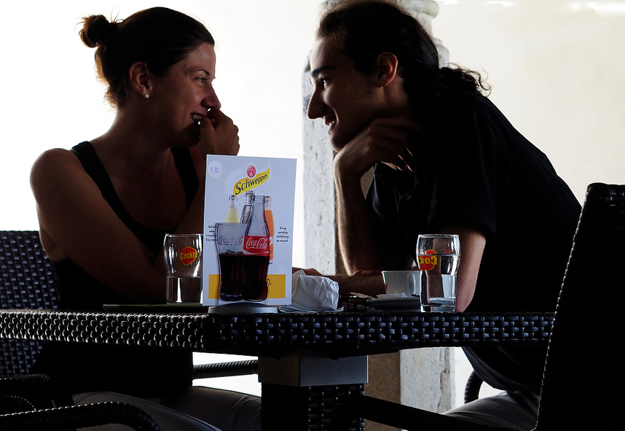

Drive States
[Instructor Name]
[Class Section Number]
Notes:
This module provides an overview of key drive states, including information about their neurobiology and their psychological effects. It can be taught in a single class period or less (35 – 50 min), with the module as a whole taking 1-2 class periods.
Technical Note: These slides may contain simple click animation so that you can focus students’ attention on a particular question, a selection of text, or an image and not have them be distracted by reading ahead. You can either preview the sequence of animation by going through the slides in slideshow view, visiting the animations tab, or reviewing the slide notes. In the notes you will see a cue - (Click) – that corresponds to each animation.
You will also find hyperlinks to outside videos at various places in the slides. These hyperlinks are embedded in text and indicated by color and in the notes section.

Slide 2
Overview
Definitions
Homeostasis
Narrowing of Attention
Intrinsic vs. Extrinsic Activity
Hunger
Sexual Arousal
Notes:
This slide provides students with an overview of the material that will be covered during the lecture.

Slide 3
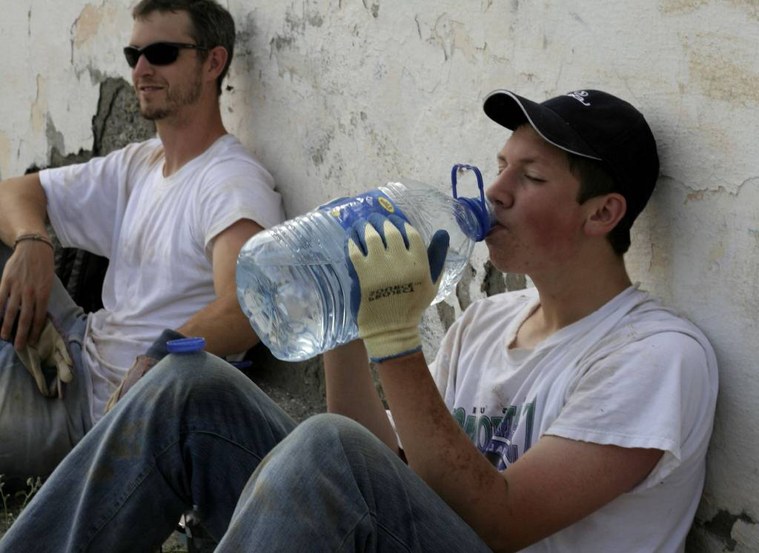
Definitions
What are some times when a physiological or biological need is all you can think about?
Drive States
Cues
Commonalities
Notes:
This slide encourages students to think critically about drive states.
Warm-Up Discussion Question: What are some occasions in our lives when our focus is completely taken over by a physiological or biological need? In the instances when this has happened what physiological or visual or other types of cues are present?
Examples: Answers students generate may include: hunger, thirst, needing to go to the bathroom, pain.
(Click) Drive States
Explanation: These are examples of drive states. Drive states, despite being uncomfortable, are affective experiences that motivate organisms to fulfill goals that are generally beneficial to their survival.
(Click) Cues
Most drive states respond to both internal and external cues, but the specific cues differ between drive states. For example, the cues for needing to cool off are different than the cues for needing warmth. Following similar logic, each drive state is also associated with distinctive behaviors, feelings, and cognitive responses.
(Click) Commonalities
Yet despite these differences, there are a number of properties common to all drive states. In this lecture, we will discuss the commonalities that apply to all drive states, as well as the cues that distinguish some typical drive states.

Slide 4
Overview
Definitions
Homeostasis
Narrowing of Attention
Intrinsic vs. Extrinsic Activity
Hunger
Sexual Arousal
Notes:
This slide provides students with an overview of the material that will be covered during the lecture.

Slide 5
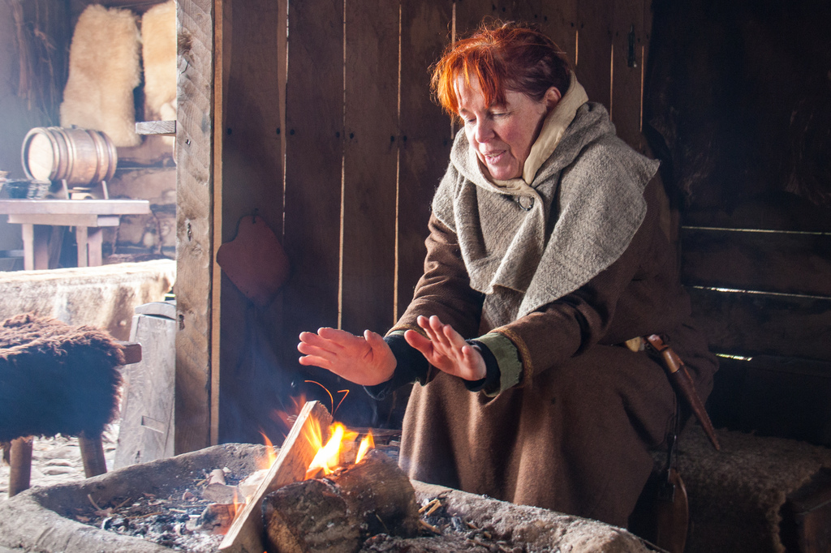
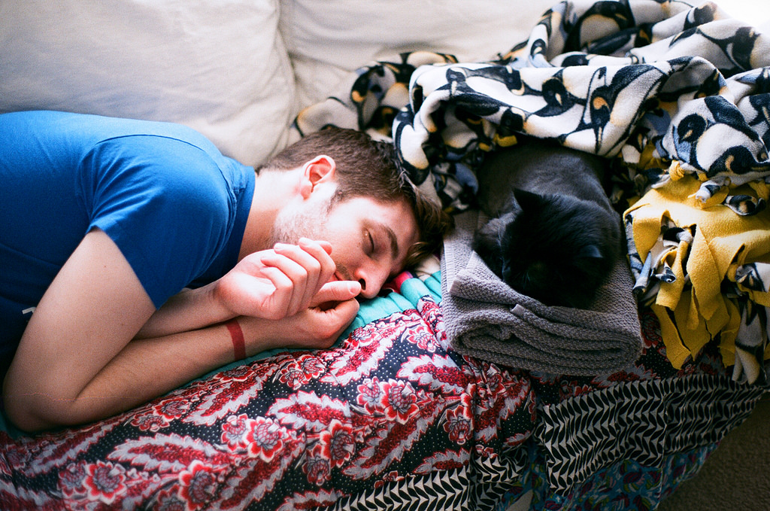
Homeostasis
Moderate and stable set point
Homeostatic Mechanisms
Automatic
Blood circulation
Immune responses
“Carrot and Stick”
Deliberate action
Bad feeling/good feeling
Notes:
This slide presents the principle of homeostasis.
We introduced the notion of commonalities across drive states earlier—things drive states share. One such commonality is homeostasis.
Explanation: Think of homeostasis as a state of equilibrium. It’s the tendency of an organism to maintain stability across all physiological systems in the body. Two factors are necessary for homeostasis:
An ideal level, or “set point”.
(Click) A mechanism or mechanisms for moving the system back to this set point.
Example: The set point for body temperature in humans is 98.6 F/ 37 C. If we deviate too much from this, our body adjusts to correct the situation: If we are too cold, we shiver to generate heat; if we are too hot, we sweat to cool down. Other examples of systems with set-points include thermostats and cruise control.
(Click) Automatic
Several mechanisms that help people maintain their set points are automatic, such as blood circulation and immune responses.
(Click) “Carrot and Stick”
Others involve a “carrot and stick” motivator, requiring a deliberate action/reaction in response to a feeling. For example, hunger is a bad feeling (the “stick”), and the pleasure derived from eating is a good feeling (the “carrot”).
Discussion Question: What are some carrot and stick mechanisms that cause you to alter your behavior to get back to your set point?
Examples: seeking shelter from a storm, pulling off at a rest stop to nap.

Slide 6
Overview
Definitions
Homeostasis
Narrowing of Attention
Intrinsic vs. Extrinsic Activity
Hunger
Sexual Arousal
Notes:
This slide provides students with an overview of the material that will be covered during the lecture.

Slide 7
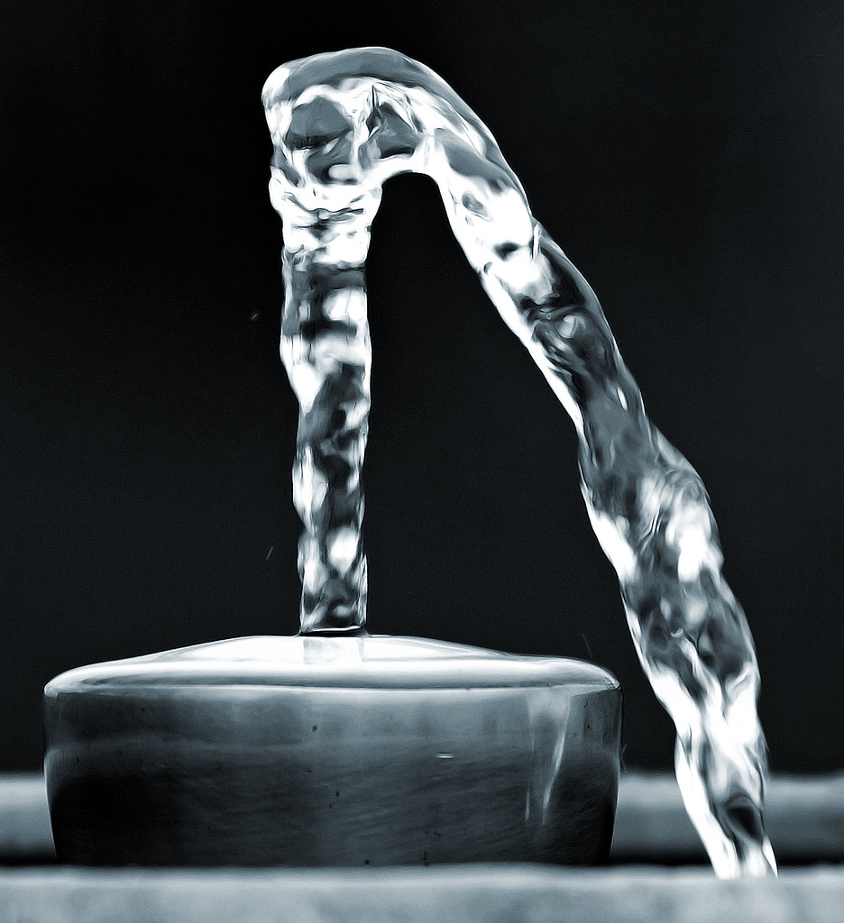
Narrowing of Attention
Thirst
⬆ Need for water
⬇ Interest in other things
⬆ Present focus
⬆ Self focus
Notes:
This slide illustrates the narrowing of attention effect on drive states using the example of thirst.
Another commonality across drive states is the narrowing of attention. “Narrowing of attention” refers to drawing attention away from the general to focus on the specific.
Explanation: When we are in need of something to recover to a state of homeostasis, our attention narrows in a variety of ways:
(Click) Need for water—In this example, a dire thirst narrows our focus.
(Click) Interest in other things: One way our attention is narrowed involves focusing on the object of our need (e.g., water to satisfy our thirst) to the exclusion of all else.
(Click) Present focus: A second way involves a preoccupation with immediacy—the collapsing of time-perspective to the present (i.e., I need the water now!, before I think about anything else).
(Click) Self focus: A third way involves prevailing self-interest—whereby the need to satisfy one’s urge overrides the interests of others (e.g., this is my water; get your own!)

Slide 8
Overview
Definitions
Homeostasis
Narrowing of Attention
Intrinsic vs. Extrinsic Activity
Hunger
Sexual Arousal
Notes:
This slide provides students with an overview of the material that will be covered during the lecture.

Slide 9
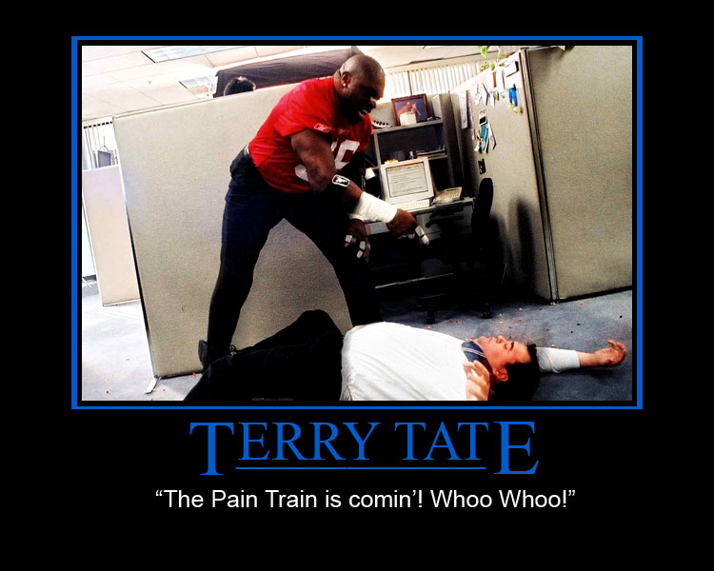
Internal vs. External
Intrinsic = Internal
Extrinsic = External
How to/How not to motivate employees
Take note of the type(s) of motivation seen in the video
Notes:
This activity examines a humorous video demonstrating intrinsic and extrinsic motivation.
(Click) Intrinsic/Extrinsic
Warm-up Discussion Question: What does it mean for motivation to be internal or external? What are some examples from your life that represent being intrinsically or extrinsically motived? Can the two types of motivation be mixed? What is your feeling about your own motivation concerning grades? Is it intrinsic, extrinsic or mixed? What about physical exercise?
(Click) How to/How not to motivate employees
Activity: Intrinsic vs. Extrinsic Motivation (For detailed instructions, see IM > Unit: Emotion and Motivation > Module 1: Drive States > Activities/Demonstrations.)
This is a mini-writing activity, so students should take out paper and something to write with.
Students are to watch the following video and write a brief response (10-15 minutes).
Explanation: Every work environment has its distinctive philosophy regarding employee motivation. Consider the different examples of motivation being demonstrated in the video. Are they external or internal? Are they effective? Might alternative motivation strategies be more effective?
Click the “How to/How not to motivate employees” hyperlink in the slide to view a humorous video demonstrating types of motivation.
Note: this clip does contain some mild swearing. If that does not appeal to you, you can do this activity by just having students offer examples of workplace motivation strategies (though students tend to enjoy this video).

Slide 10
Overview
Definitions
Homeostasis
Narrowing of Attention
Intrinsic vs. Extrinsic Activity
Hunger
Sexual Arousal
Notes:
This slide provides students with an overview of the material that will be covered during the lecture.

Slide 11
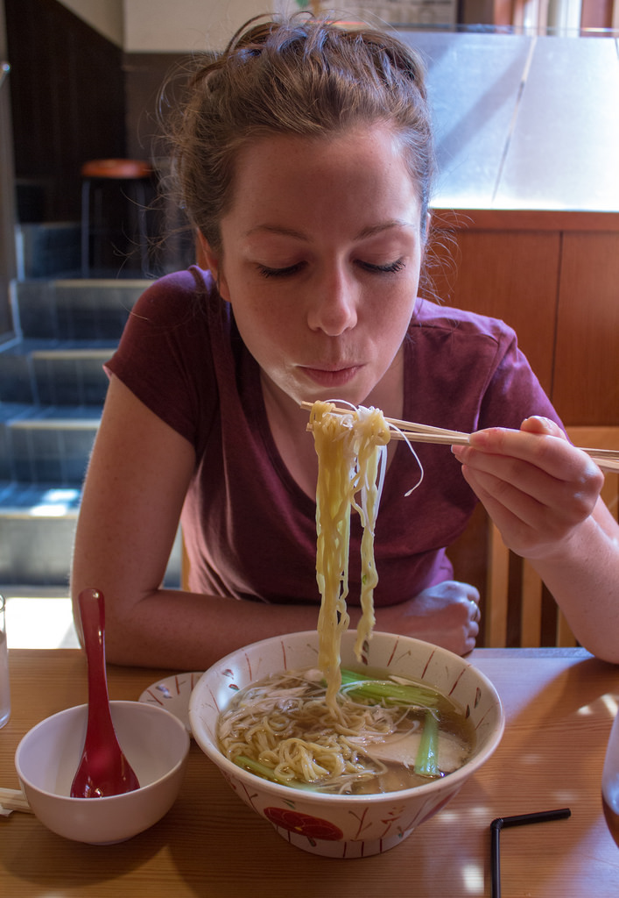
Hunger
Internal cue
Triggered by drop in glucose
External cue
Time of day
Time until next feeding
Exposure
Notes:
This slide further explores the concept of drive states, using hunger as an example.
Hunger is an example of a drive state that is triggered by both internal and external cues.
(Click) Internal cue
Hunger is generally triggered by low glucose levels in the blood, which is an internal cue. As a result of a drop in glucose, the body sends signals to the hypothalamus in the brain, which then triggers thoughts and behaviors associated with food consumption.
(Click) External cue
Hunger can also be stimulated by external sensorial cues, such as sight, smell, taste, and even touch. Other external cues include the time of day and the estimated time until the next feeding (hunger increases immediately prior to food consumption).
Discussion Question: What are some situations where external cues have stimulated your hunger?
Examples students generate might include: walking into a bakery, lighting a barbeque, sizzling bacon, seeing a restaurant sign.
Further Discussion Question: What are some other ways extrinsic cues might affect eating behavior?
Examples students generate might include: social/cultural cues, such as body image, food advertisements, access to types of food or ingredients.

Slide 12
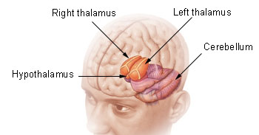
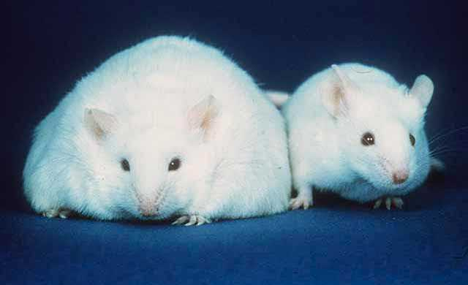
Hunger in the Hypothalamus
Lateral Hypothalamus
Lesion ⬇ Hunger
Stimulate ⬆ Hunger
Right thalamus
Left thalamus
Cerebellum
Hypothalamus
Ventromedial Hypothalamus
Lesion ⬆ Eating
Notes:
This slide illustrates the mechanisms within the brain that drive hunger.
The hypothalamus plays a very important role in eating behavior. The lateral hypothalamus (LH) is concerned largely with hunger. For example, lesions of the LH can actually result in eliminating eating—to the point where animals will starve to death unless kept alive by force feeding. Additionally, artificially stimulating the LH, using electrical currents, can generate eating behavior if food is available
(Click) Ventromedial Hypothalamus
The ventromedial hypothalamus (VMH) plays an important role in satiety. Lesions of the VMH can make an animal overeat to the point of obesity (such as seen in this rat).
Instructor’s Note: Other brain areas also play an important role in eating behavior:
The visual, olfactory, and taste sensual cortices assist in identifying food.
Neurons in the orbitofrontal cortex, where reward values are processed, fire more rapidly at the sight or taste of food when an organism is hungry.

Slide 13
Overview
Definitions
Homeostasis
Narrowing of Attention
Intrinsic vs. Extrinsic Activity
Hunger
Sexual Arousal
Notes:
This slide provides students with an overview of the material that will be covered during the lecture.

Slide 14
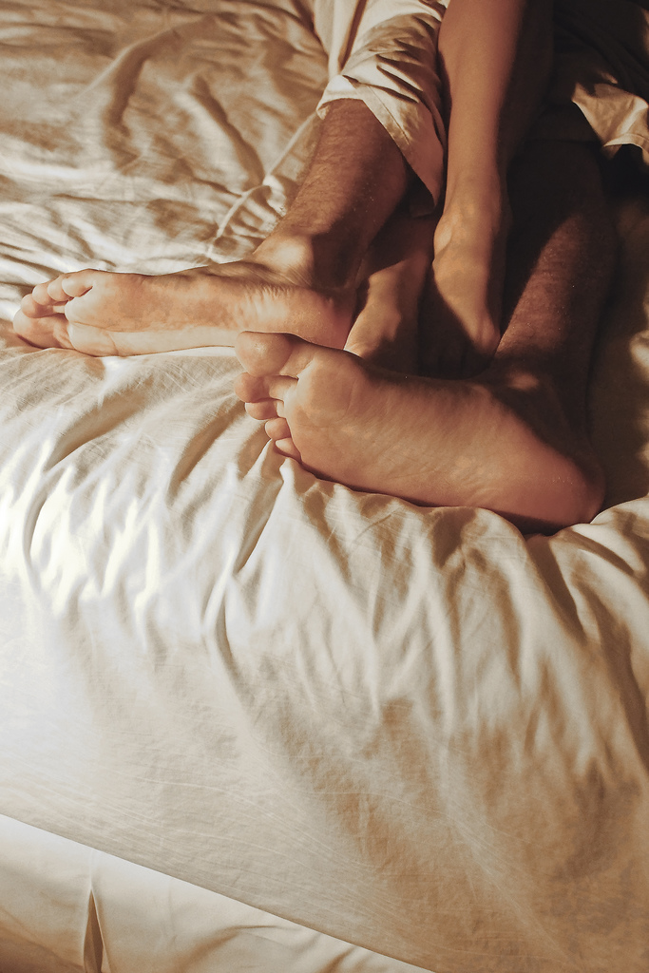
Sexual Arousal
Internal and external cues trigger sexual arousal
Gender Differences:
Preoptic area ➔ males
Ventromedial hypothalamus ➔ females
Notes:
This slide presents distinctions between male and female sexual arousal drive states.
Sexual arousal is another drive state that can be triggered by a range of internal and external mechanisms.
Discussion Question: What are some ways extrinsic cues might affect sexual interest/behavior?
Examples students generate might include: seeing an attractive person in public, watching media promoting sexuality, responding to sexual/romantic advances, body image.
(Click) Gender Differences
Unlike hunger, however, these mechanisms can differ substantially between males and females, indicating important evolutionary differences in the biological functions that sexual arousal serves for different sexes.
(Click) Preoptic area
In males, sexual arousal and pleasure is strongly related to the preoptic area, a region in the anterior hypothalamus involved in generating and regulating male sexual behavior.
If the preoptic area is damaged, male sexual behavior is severely impaired.
Instructor’s Note: Interestingly, damage to the preoptic area does not affect certain types of sexual motivations. For example, rats that have had prior sexual experiences will still seek out sexual partners after their preoptic area is lesioned. However, once having secured a sexual partner, they will show no further inclination to actually initiate sex.
(Click) Ventromedial hypothalamus
In females, the ventromedial hypothalamus plays a similar role. Neurons in the ventromedial hypothalamus determine the excretion of estradiol, an estrogen hormone that regulates sexual receptivity in many mammals. These neurons send impulses to the periaqueductal gray, a region in the midbrain responsible for defensive behaviors (such as freezing immobility, running, increases in blood pressure, and so on) and other motor responses. During sexual arousal, these defensive responses are weakened and lordosis (mating posture) behavior is initiated.

Slide 15
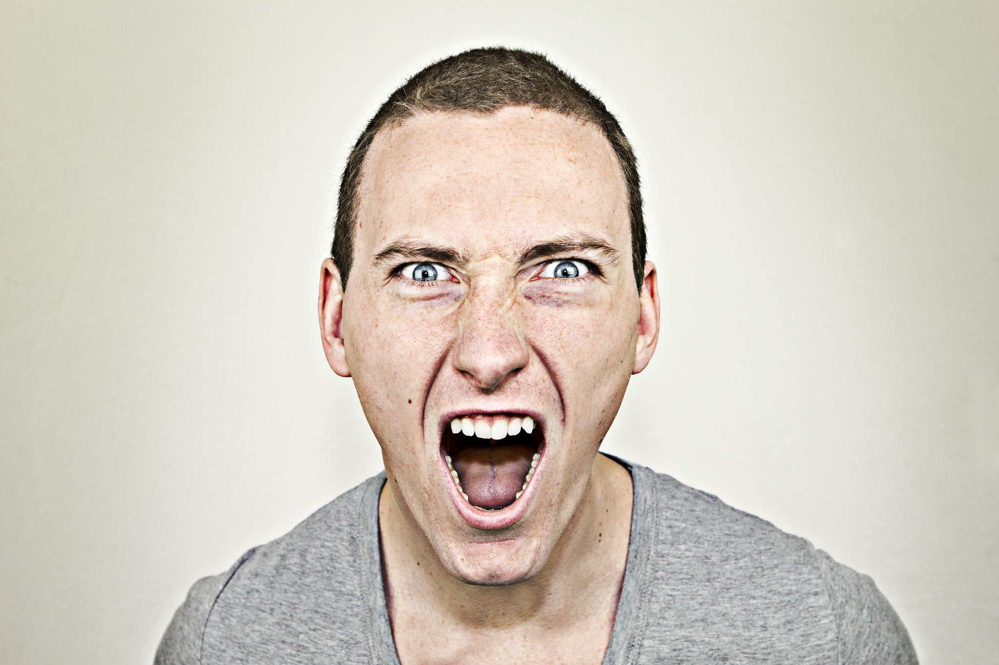
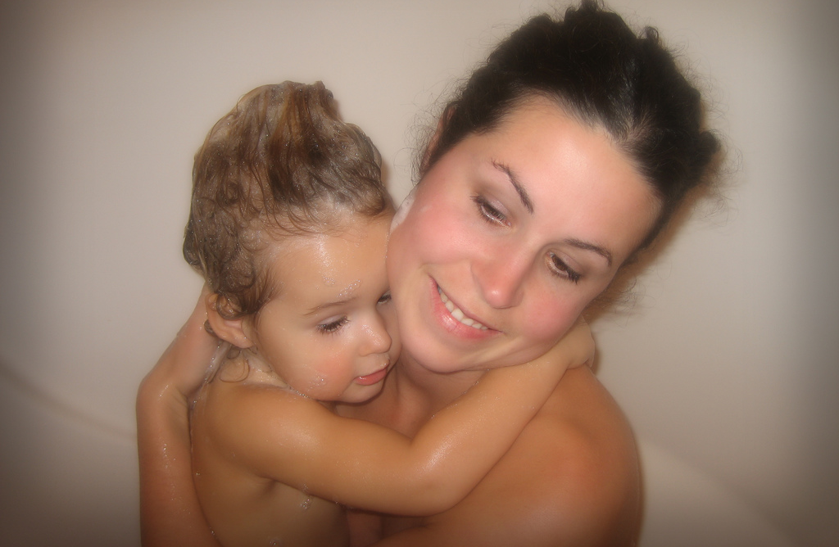
Sexual Arousal and the Brain
Male brain
Sex & Aggression
Female brain
Sex & Nurturance
Septal nucleus is key
Notes:
This slide further illuminates the differences between male and female brains in terms of sexual activity/reactivity.
Other differences between males and females involve overlapping functions of neural modules, providing insight into possible biological roles shared by sexual arousal and sexual activity. For example:
(Click) Male brain
Areas of the brain that are important for male sexuality overlap to a great extent with areas that are also associated with aggression.
(Click) Female brain
In contrast, areas important for female sexuality overlap extensively with those that are also connected to nurturance.
(Click) Septal nucleus
One commonality between male and female sexuality is the crucial role played by the septal nucleus. This area of the brain receives reciprocal connections from many other brain regions, including the hypothalamus and the amygdala. The septal nucleus shows considerable activity, in terms of rhythmic spiking, during sexual orgasm in both males and females.
Instructor’s Note: In humans, stimulating this region—either electrically or by placing a small amount of acetylcholine into it—has been reported to produce a feeling of imminent orgasm.

Slide 16
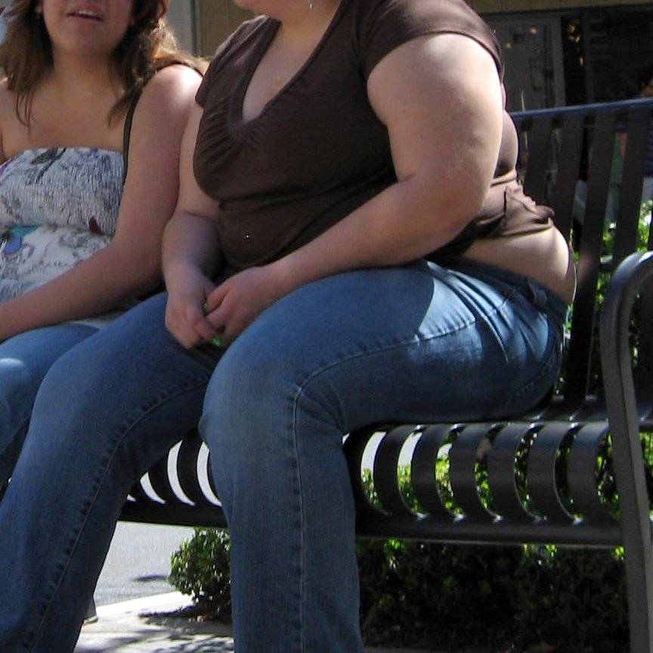
Conclusion
Survival is the goal
Different drive states, different reliance on cues
Mismatch in drive states = trouble
Notes:
This slide summarizes the information presented in this lecture and provides a prompt for further examination.
Recap: Drive states are evolved motivational mechanisms designed to ensure that organisms take self-beneficial actions.
Explanation: There are many drive states, other than hunger and sexual arousal, that share the properties discussed in this module, and which affect us on a daily basis. It’s important to note, however, that each drive state has its own unique features as well. One of the key differences between drive states is the extent to which they are triggered by internal and external stimuli. Thirst, for example, is induced both by decreased fluid levels and an increased concentration of salt in the body. Fear, on the other hand, is induced by perceived threats in the external environment. Drug cravings are triggered both by internal homeostatic mechanisms and by external visual, olfactory, and contextual cues.
Further Explanation: One final thing to consider is the real-world consequences of drive states: at times they lead us to behave in ways that are ill-suited to our modern lives. Our drive states have evolved over millions of years, and are not necessarily effective at responding to our fast-changing modern environments:
Consider, for example, the obesity epidemic affecting countries around the world. Like other diseases of affluence, obesity is a product of drive states that are too easily fulfilled: homeostatic mechanisms that worked well when food was scarce backfire when a meal rich in fat and sugar is readily available.
Unrestricted sexual behaviors can have a similarly adverse effects on our well-being, personally, socially, and culturally.
Many problems of the 21st century, from school massacres to obesity to drug addiction, are influenced by the mismatch between our drive states and our uniquely modern ability to fulfill them at a moment’s notice.

Slide 17
Conclusion
Slide 1 | Photo Credit: Peter Morgan http://www.flickr.com/photos/pmorgan/5001573288/ https://creativecommons.org/licenses/by-nc-nd/2.0/
Slide 3 | Photo Credit: Andrew E. Larsen http://www.flickr.com/photos/38551575@N00/3765197028 https://creativecommons.org/licenses/by-nd/2.0/
Slide 5 | Photo Credit: Laura D'Alessandro https://www.flickr.com/photos/flossyflotsam/14006827933/ https://creativecommons.org/licenses/by/2.0/
Slide 5 | Photo Credit: Hans Splinter http://www.flickr.com/photos/67196253@N00/7060798719 https://creativecommons.org/licenses/by-nd/2.0/
Slide 7 | Photo Credit: Ian Sane http://www.flickr.com/photos/31246066@N04/4345271118/ https://creativecommons.org/licenses/by/2.0/
Slide 9 | Photo Credit: jasondefra https://www.flickr.com/photos/8977890@N04/2970013462/ https://creativecommons.org/licenses/by/2.0/
Slide 11 | Photo Credit: Simon Q http://www.flickr.com/photos/10287726@N02/14301141166 https://creativecommons.org/licenses/by/2.0/
Slide 12 | Photo Credit: Bigplankton http://commons.wikimedia.org/wiki/File:Fatmouse.jpg http://en.wikipedia.org/wiki/Public_domain
Slide 12 | Photo Credit: http://commons.wikimedia.org/wiki/File:Illu_diencephalon.jpg http://en.wikipedia.org/wiki/Public_domain
Slide 14 | Photo Credit: Matthew Romack http://www.flickr.com/photos/11324320@N08/2357016368 https://creativecommons.org/licenses/by/2.0/
Slide 15 | Photo Credit: .Photoss. https://www.flickr.com/photos/62821507@N03/7052574663/ https://creativecommons.org/licenses/by-nc-sa/2.0/
Slide 15 | Photo Credit: Poor Shlub https://www.flickr.com/photos/22436239@N06/2229337285/ https://creativecommons.org/licenses/by-nc/2.0/
Slide 16 | Photo Credit: Malingering https://www.flickr.com/photos/malingering/2314262736/in/faves-55291952@N06/ https://creativecommons.org/licenses/by-nc-nd/2.0/
Notes:
This slide summarizes the information presented in this lecture and provides a prompt for further examination.
Recap: Drive states are evolved motivational mechanisms designed to ensure that organisms take self-beneficial actions.
Explanation: There are many drive states, other than hunger and sexual arousal, that share the properties discussed in this module, and which affect us on a daily basis. It’s important to note, however, that each drive state has its own unique features as well. One of the key differences between drive states is the extent to which they are triggered by internal and external stimuli. Thirst, for example, is induced both by decreased fluid levels and an increased concentration of salt in the body. Fear, on the other hand, is induced by perceived threats in the external environment. Drug cravings are triggered both by internal homeostatic mechanisms and by external visual, olfactory, and contextual cues.
Further Explanation: One final thing to consider is the real-world consequences of drive states: at times they lead us to behave in ways that are ill-suited to our modern lives. Our drive states have evolved over millions of years, and are not necessarily effective at responding to our fast-changing modern environments:
Consider, for example, the obesity epidemic affecting countries around the world. Like other diseases of affluence, obesity is a product of drive states that are too easily fulfilled: homeostatic mechanisms that worked well when food was scarce backfire when a meal rich in fat and sugar is readily available.
Unrestricted sexual behaviors can have a similarly adverse effects on our well-being, personally, socially, and culturally.
Many problems of the 21st century, from school massacres to obesity to drug addiction, are influenced by the mismatch between our drive states and our uniquely modern ability to fulfill them at a moment’s notice.

